Slide 1

demo
By Miguel Arriaga Velasco

Slide 2

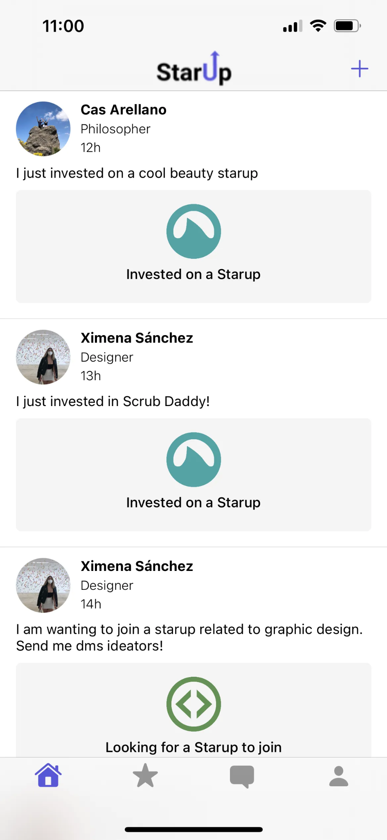
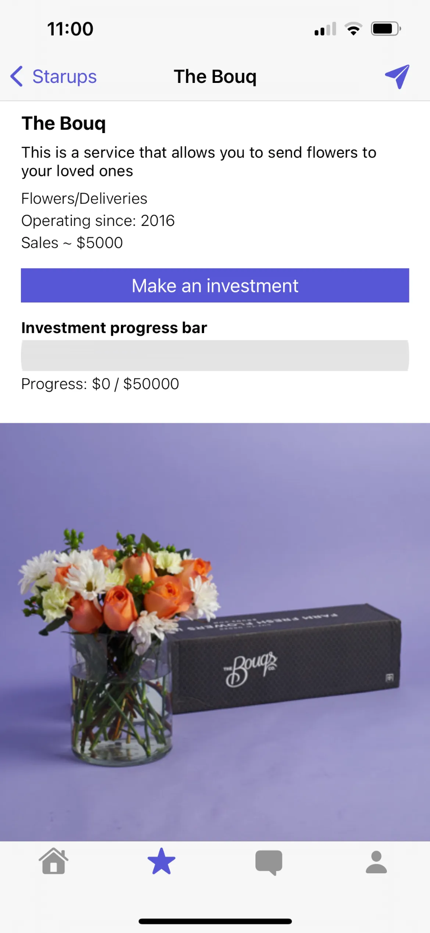
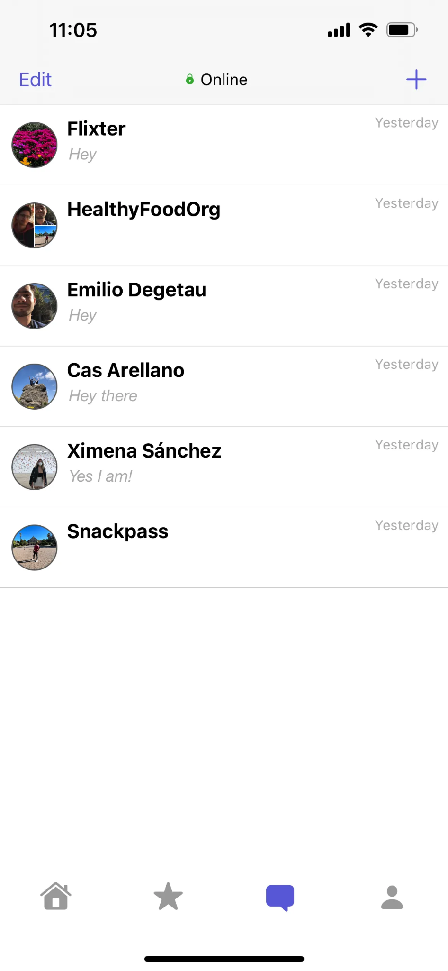
The idea
Starup is an iOS app that connects startups, investors and collaborators.
Users can post new starups, invest in them or join them.
Sharks - Investors
Ideators - Startup creator
Hackers - Startup “employees”

Slide 3








Main tools

Slide 4
complex features

Slide 5
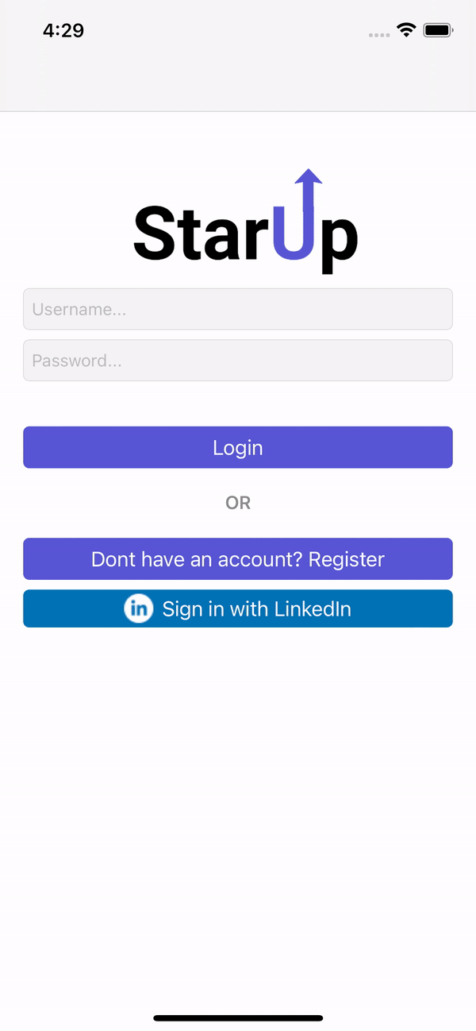
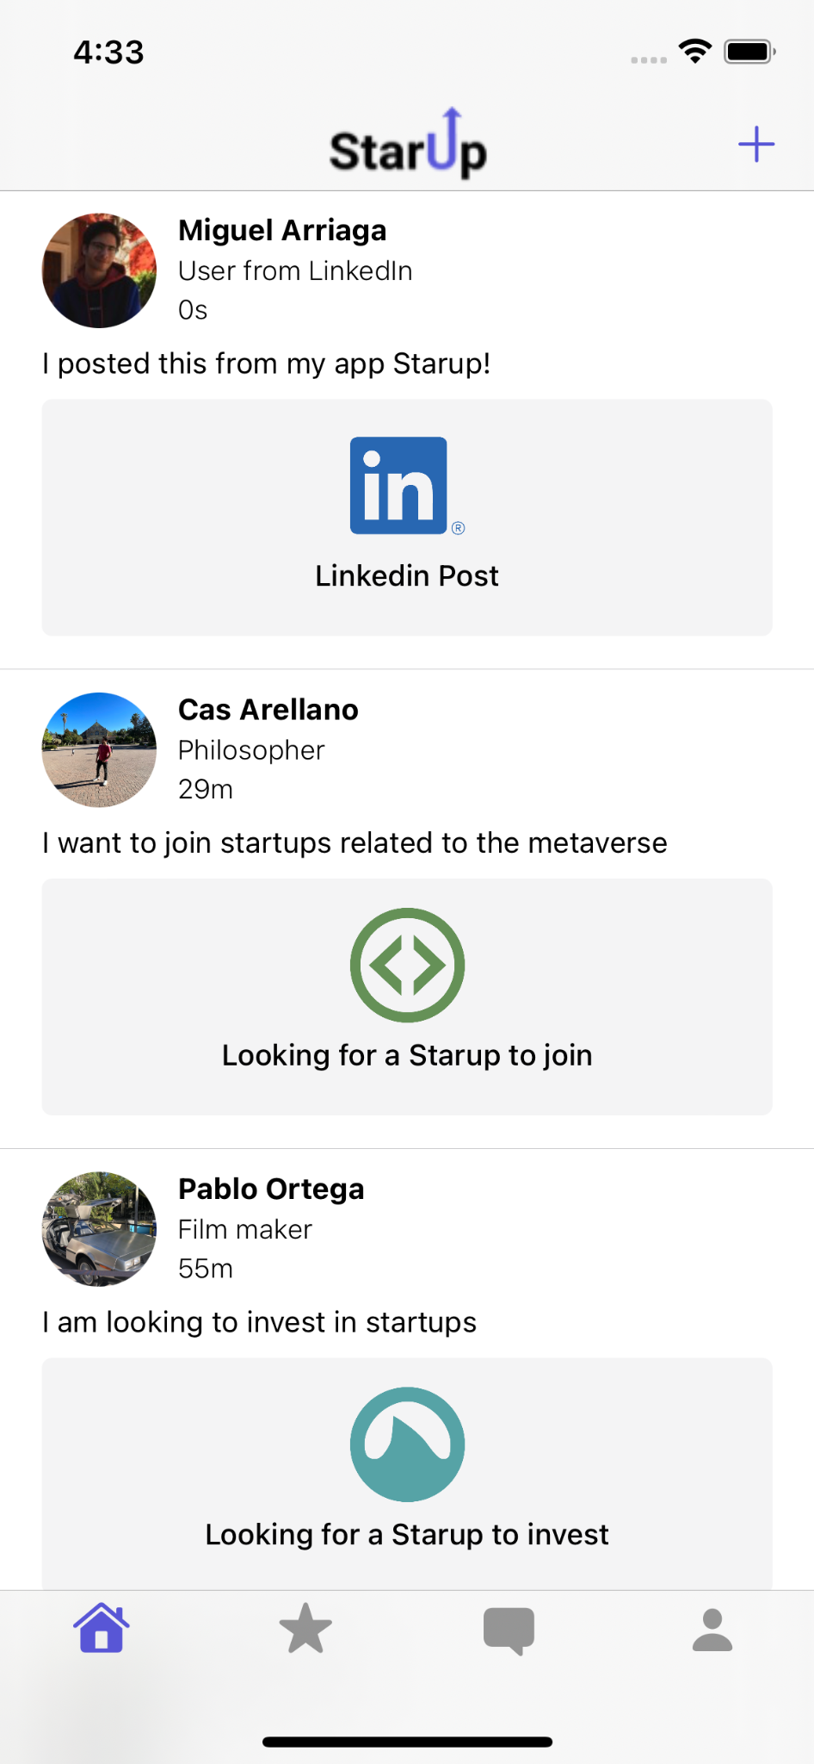
Linkedin integration
Authenticate with Linkedin
Post to Linkedin

Slide 6
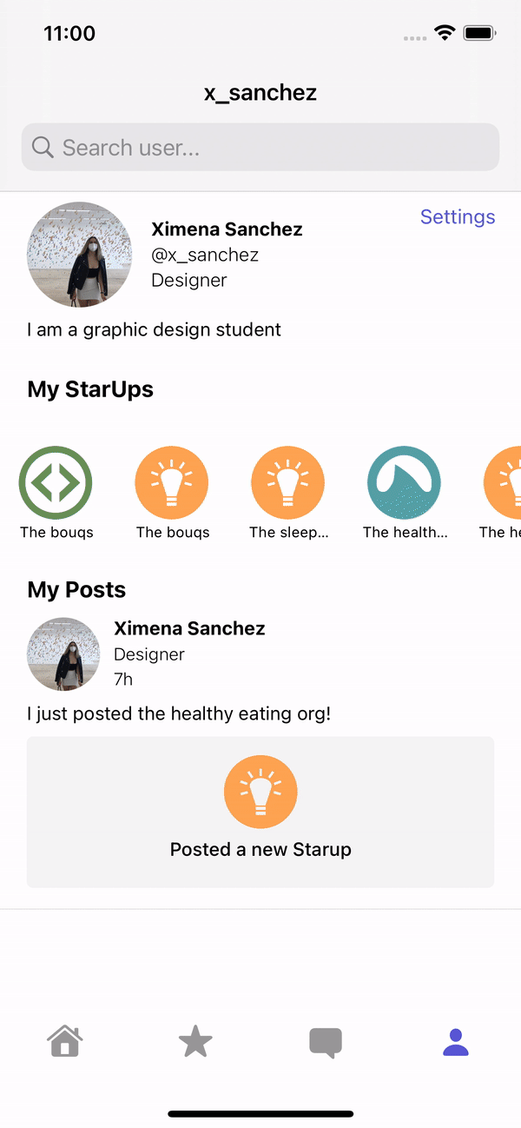
Search
Built a graph data structure in the server to measure "closeness" between users.
When the user makes a search, a local graph will be traversed looking for users that match the search.
Sectioning: recommended, you may know, discover.

Slide 7
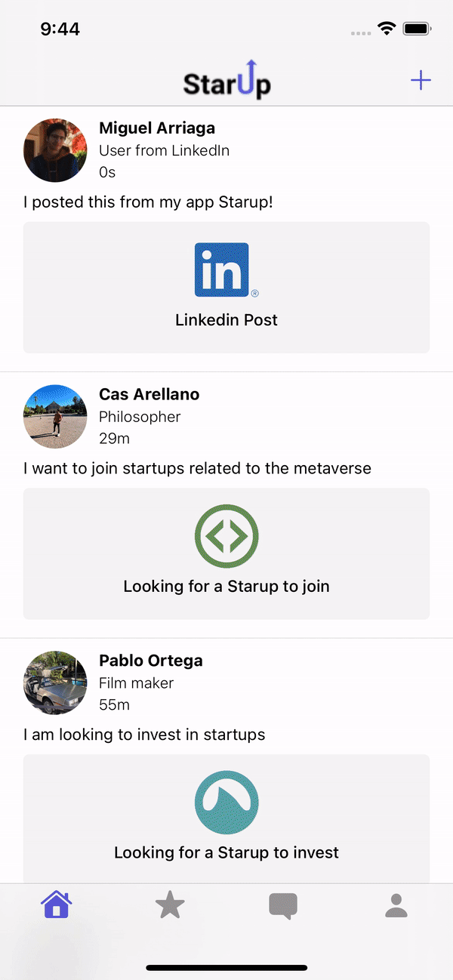
Messaging
Contacts are added using the connections graph previously built.
Users can manage their conversations: add users, remove users, delete messages, delete conversations, etc.
After a new Starup is created, a group chat will be automatically created with all the members of that Starup.

Slide 8
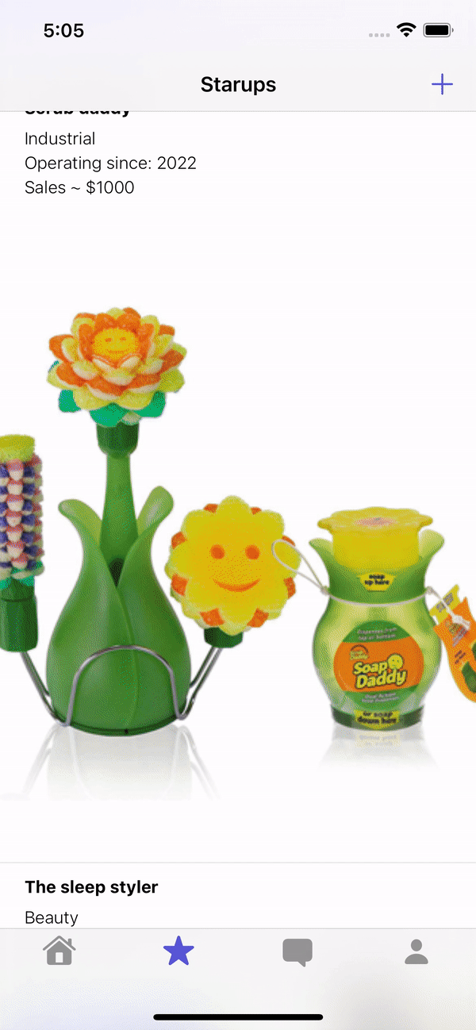
Payments
The user is able to make investments through the Paypal API.
The user can select any of Paypal payment methods.
Automatically update Starup ownership.
Calculate percentages automatically.

Slide 9

full demo
https://www.internalfb.com/intern/px/p/29hVr?ov

